Slide 1
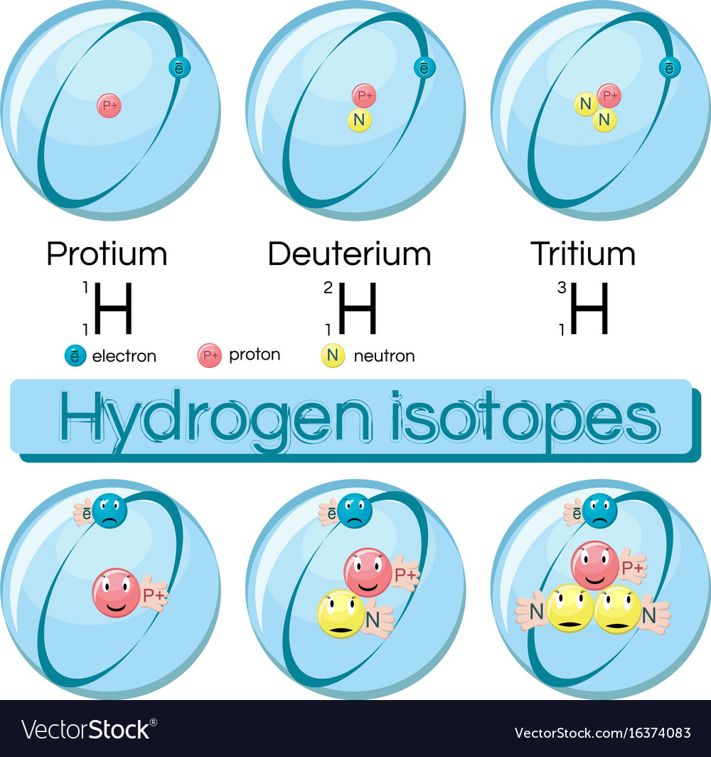
Isotopes, Relative Atomic Mass and Mass Spectrometry

Slide 2
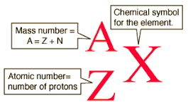
The accepted convention for representing isotopes
X = the symbol of the element
A = Mass number
Z = Atomic number
Atomic number = number of protons
Z = N(p)
Mass number = number of proton plus neutrons
A = N(p)+N(n)
IUPAC Nuclear Notation

Slide 3
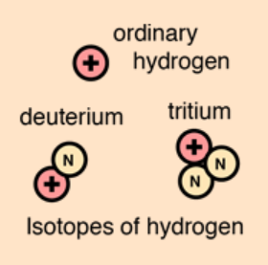
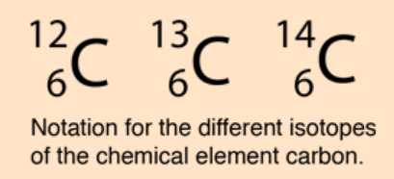
Atoms and Isotopes
Different isotopes of a given element have the same atomic number but different mass numbers since they have different numbers of neutrons
Hyphen notation:
e.g. carbon-12 or carbon-14

Slide 4
Isotopes have the same chemical properties (as they have the same number of electrons)
Isotopes may have different physical properties such as density, boiling point (due to the different mass of the atom)
Larger isotopes can have an unstable nucleus and may be radioactive
Isotopes

Slide 5
Recall – scientists discovered that elements combined in specific ratios to form compounds. {Proust – Law of Definite proportions}
Dalton (1766-1844) used this to calculate the relative atomic mass of different elements
For example: calcium and oxygen always combined in a mass ratio of 2.5 g calcium to 1.0 g oxygen. Assuming the atomic ratio is 1:1, that would make an atom of calcium 2.5 times heavier than an atom of oxygen.
Relative atomic mass is the mass of the atom compared to 1/12th the mass of a carbon-12 atom
Relative atomic mass (Ar)

Slide 6
Relative atomic mass is the mass of the atom compared to 1/12th the mass of a carbon-12 atom
The mass og an individual isotope of each element compared to this standard is called the relative isotopic mass.
Recall: mass number gives protons + neutrons
Relative isotopic mass is found experimentally, as protons and neutrons are close to 1 on the carbon-12 scale the relative isotopic mass is almost equal to the mass number
Example: Chlorine-37 has a relative isotopic mass of 36.966
Relative isotopic mass

Slide 7
Relative atomic mass has no units as it is a comparison to the standard, carbon-12
Natural samples contain a mixture of isotopes
We can calculate the average atomic mass for a naturally occurring mixture of isotopes.
If an element has naturally occurring, stable isotopes the relative atomic mass is the weighted average based on the abundance of the individual isotopes.
Ar = (% abundance isotope a) x Ar(a) + (% abundance isotope b) x Ar(b)
100
Relative atomic mass (Ar)

Slide 8
Calculate the relative atomic mass of chlorine, using the information below:
Chlorine exists as two stable isotopes in nature
75.77 % is Cl-35, relative isotopic mass = 34.97
24.23 % is Cl-37, relative isotopic mass = 36.97
Ar (Cl) = (75.77 x 34.97) + (24.23 x 36.97)
= 35.45
100
Check - What is the relative atomic mass for chlorine on the periodic table?
Relative atomic mass (Ar)

Slide 9
Chlorine exists as two stable isotopes, Cl-35 and Cl-37, in nature and has a Ar = 35.45. Given the isotopic masses of the two isotopes below calculate the relative abundance of each.
Cl-35, relative isotopic mass = 34.97
Cl-37, relative isotopic mass = 36.97
Ar = (% abundance isotope a) x Ar(a) + (% abundance isotope b) x Ar(b)
100
Ar (Cl) = (34.97 x a) + (36.97 x (100 –a))
= 35.45
100
34.97a + 3697 – 36.97a
= 35.45
100
= 35.45 x 100
34.97a + 3697 – 36.97a
34.97a – 36.97a
= 3545 - 3697
-2a
= -152
a
= 76
Cl-35 have % abundance of 76 % and Cl-37 have % abundance of 100 – 76 = 24 %

Slide 10
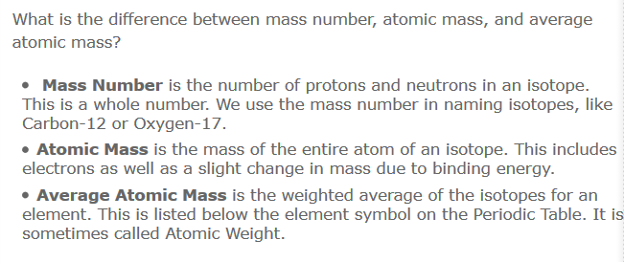
Relative atomic mass (Ar)

Slide 11
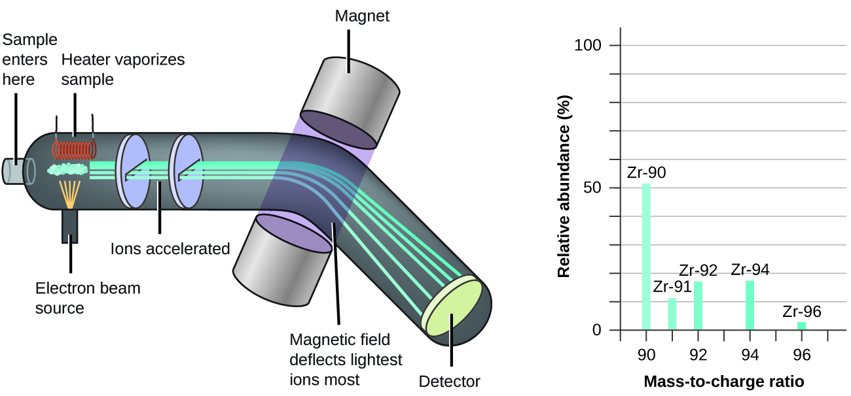
Mass spectrometry

Slide 12
The operation of the MS has several key steps:
Vaporisation of the sample
Ionisation of the vaporized sample
Acceleration and separation of the resulting ions based on their mass to charge ratio ( m/z )
Acceleration – in an electric field.
Deflection – in a magnetic field. Ions of lower mass experience more deflection, travel in a smaller radius.
Detection or counting the number of each of the ions of different mass to charge ratio
Mass spectrometry

Slide 13
magnet
Light ions
Small m/z
Heavy ions
large m/z
Mass spectrum

Slide 14
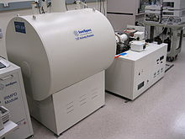
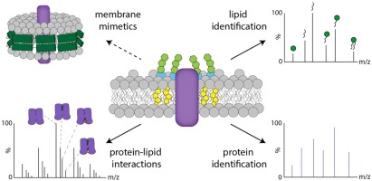
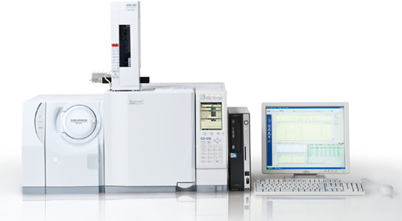
Mass spectrometry can be used to determine the relative atomic mass of the isotopes of an element. This is its simplest application, it is used in research and analytic application such as detecting trace levels of illicit substances, exploring the structure of organic compounds, and identifying proteins.
Mass spectrometry

Slide 15
Zirconium MS shown here, has 5 isotopes – Zr-90, Zr-91, Zr-92, Zr-94, Zr-96
To calculate the Relative atomic mass of zirconium you need the mass number and % abundance.
Read % abundance off the graph or measure the height of each peak, height of peak / total height all the peaks x 100.
MS to calculate Relative atomic mass

Slide 16
Read: Pearson 2.3 – 2.4
Answer questions: Pearson section reviews 2.3, 2.4 and Chapter 2 review.
Mass spectrometry

Slide 17
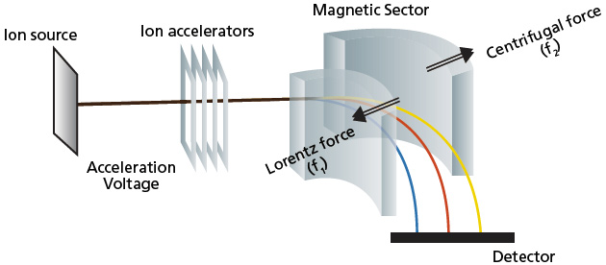
Extra diagram

